Slide 1

ONLINE MOBILE RECHARGE SYSTEM

Slide 2



OUR TEAM
NAVEETH Z A RAJAGURUNATHAN M SARAVANAKUMAR B

Slide 3

AGENDA
Project overview
About Rpay
Our service providers
Tools & Technologies
Web API , Angular 10 & Database design
Project flow
User module
Chatbot
Admin Dashboard
Our Product Benefits

Slide 4

PROJECT OBJECTIVE
Single click Recharge system.
Elegant UI with Multiple plans.
Hybrid & High secured wallet system.
Role based Access to a platform
People’s SAAS product

Slide 5

ABOUT RPAY
Online Mobile Recharge System is a Web Based Application(RPAY)
developed to recharge prepaid Mobile numbers.
This System focuses at providing an Easy and
Reliable Platform to Recharge Mobile
of any Telecommunication Company through
Online without Buying Recharge Card

Slide 6



OUR SERVICE PROVIDERS
Jolo API ​ is a online recharge and bill portal.
They provide online instant mobile recharge service.
Razorpay is the only payments solution in India that allows businesses to accept, process and disburse payments with its product suite.
Collect chat is an interactive chatbot that collects data from website visitors - 24/7, fully on auto-pilot.

Slide 7








TOOLS AND TECHNOLOGIES
PROJECT TYPE : Web Application
TECH STACK : Angular 10
.Net Core 2.1 Web API
JWT, Bootstrap
SQL, Angular Material Designs
TOOLS USED: Visual Studio 2019
Visual Studio code
Postman
MS SQL Server Management Studio

Slide 8
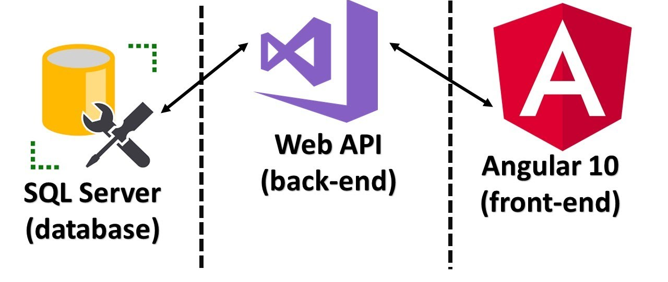
WEB API & ANGULAR & DATABASE

Slide 9
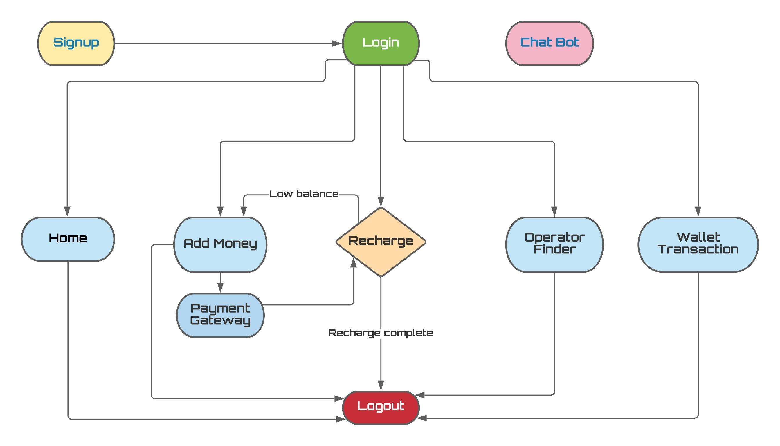
PROJECT FLOW

Slide 10

USERMODULES
SIGNUP
LOGIN
RECHARGE
OPERATOR FINDER
WALLET HISTORY
LOGOUT
ADD MONEY TO WALLET

Slide 11

Signup & login
Signup
User will enter his/her details to create a account in the Rpay.
Password will be hashed & stored to maintain
High security service.
Login
User will enter his/her credentials to logged in.
User session will be managed using Json Web Token (JWT).
JWT Signature gets expired after 24 hours from the token issued time.

Slide 12
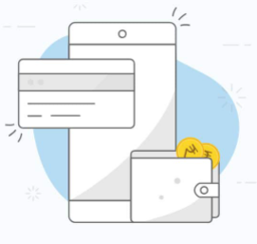
ADD MONEY TO WALLET
User will select the money he/she need.
Then user will directed to Razor pay Payment Gateway.
In that gateway
User will enter his/her credentials.
Select payment mode
OTP Verification
Payment Success & Amount will be captured.
Payment response will be sent as email to the user.
User will able to see his/her wallet transaction history in Wallet section.

Slide 13



OUR MOBILE NETWORK PARTNERS

Slide 14
RECHARGE
Displays various plans with different operators.
User will select his desire plan dynamically by filtering network operator.
Once user clicks recharge button
If plan amount less than user current balance , user will be requested to
Add money to proceed his recharge.
Else his recharge will be completed and the amount will get debited from his money wallet.
If recharge failed user will get instant refund.
User will get notified by SMS response from his respective network operator.
Now current plan will be shown in his mobile network application.

Slide 15

OPERATOR FINDER
User will enter the mobile number and the respective network
operator logo and name will be displayed
Ported number will show only the old network operators name.
This feature is helpful when the user recharge his
friends/ family members number.

Slide 16
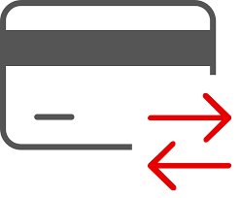
WALLET HISTORY & LOGOUT
User’s wallet history will be shown based on the recent transaction.
Each transaction have unique transaction id which is
useful for monitoring the transactions in admin(JoloAPI) dashboard.
Once user clicks logout JWT signature will get expired.
User’s session will be closed.

Slide 17

CHATBOT
“Client.chat” - chatbot service provider.
Human Friendly.
Interactive & Interesting user experience.
24x7 Customer support
Support claim will be raised as an email by default.

Slide 18

ADMIN(JoloAPI) DASHBOARD
Admin can able to monitor recharge transactions(both success & failed transactions)
Admin can able to monitor the plans for the respective operators.
Admin can solve the queries of the user in help desk.
Admin can monitor user details.

Slide 19

OUR PRODUCT BENEFITS
High Security service.
24x7 Customer support using Chat bot.
Instant Refund service, If Recharge failed.
Easy Transaction Monitoring.
For every transaction , there will be a commission
for the client and it will based on tarrif plan.

Slide 20

DEMO TIME

Slide 21

TIME FOR QUERIES

Slide 22

Thank You
RPAY TEAM

